Slide 1
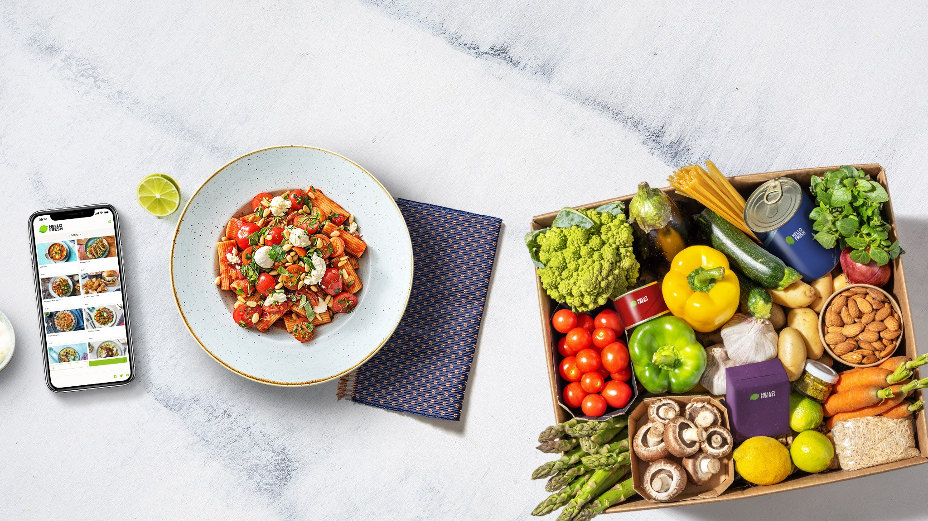
HelloFresh Analytics Engineer SQL Test

Slide 2
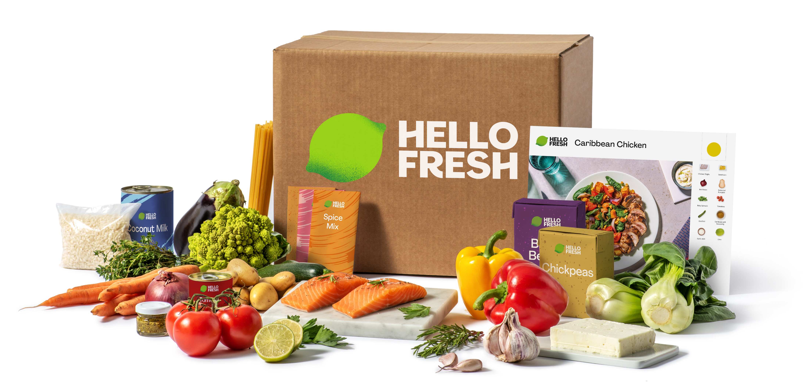
Contents
Sr No. | Particulars | Slide No
1 | Methodology | 3
2 | E-R diagram | 4
3 | Query resolution | 5

Slide 3


Methodology
Table creation
Pre- processing data
Query Execution
Create the required tables in Microsoft SQL Server Management Studio based on the provided entity-relationship (E-R) diagram(Refer the next slide for the ER diagram )
Added dummy values to each table, ensuring that the values correspond to the attributes and data types defined for each column
Executed and verified the SQL statements for each question, ensuring that the results matched the expected outcomes

Slide 4
E-R diagram
Analysing the relationship between the tables to execute the queries
Joining the tables according to the corresponding Primary & Foreign key

Slide 5

2
Solutions
Section

Slide 6

Question 1
For the customer with the email address ‘fancygirl83@hotmail.com’ show all product_skus the customer has an active subscription for
Answer:
SELECT c.EMAIL, p.PRODUCT_SKU
FROM product p
JOIN subscription s ON p.ID_PRODUCT = s.FK_PRODUCT_SUBSCRIBED_TO
JOIN customer c ON s.FK_CUSTOMER = c.ID_CUSTOMER
WHERE c.EMAIL = 'fancygirl83@hotmail.com' AND s.STATUS = 'Active';

Slide 7
Question 2
Get all the customers that have an active subscription to a product that corresponds to a product family with product_family_handle = ‘classic-box’
Answer:
SELECT c.ID_CUSTOMER,c.FIRST_NAME,c.LAST_NAME,c.EMAIL
FROM customer c
JOIN subscription s ON c.ID_CUSTOMER = s.FK_CUSTOMER
JOIN product p ON s.FK_PRODUCT_SUBSCRIBED_TO = p.ID_PRODUCT
JOIN product_family pf ON p.FK_PRODUCT_FAMILY = pf.ID_PRODUCT_FAMILY
WHERE s.STATUS = 'Active'
AND pf.PRODUCT_FAMILY_HANDLE = 'classic-box’;
Note: ( I am not retrieving the customer password information in this query )

Slide 8
Question 3
Get all the paused subscriptions that have only received one box
Answer:
SELECT *
FROM subscription s
JOIN orders o ON s.ID_SUBSCRIPTION = o.FK_SUBSCRIPTION
WHERE s.STATUS = 'Paused'
GROUP BY s.ID_SUBSCRIPTION
HAVING COUNT(o.ID_ORDER) = 1;

Slide 9
Question 4
How many subscriptions do our customers have on average?
Answer:
SELECT AVG(sub_count) AS average_subscriptions
FROM (
SELECT COUNT(*) AS sub_count
FROM subscription
WHERE STATUS <> 'cancelled'
GROUP BY FK_CUSTOMER
) AS sub_counts;
Note : Here I am finding the subscription average by neglecting the cancelled status

Slide 10
Question 5
How many customers have ordered more than one product?
Answer:
SELECT COUNT( c.ID_CUSTOMER) AS customer_count
FROM customer c
JOIN subscription s ON c.ID_CUSTOMER = s.FK_CUSTOMER
JOIN orders o ON s.ID_SUBSCRIPTION = o.FK_SUBSCRIPTION
GROUP BY c.ID_CUSTOMER
HAVING COUNT(DISTINCT o.ID_ORDER) > 1;

Slide 11
Question 6
How many customers have ordered more that one product with the same subscription?
Answer:
SELECT COUNT(DISTINCT c.id_customer) AS num_customers
FROM Customer c
INNER JOIN Subscription s ON c.id_customer = s.fk_customer
INNER JOIN Order o ON s.id_subscription = o.fk_subscription
GROUP BY c.id_customer, s.id_subscription
HAVING COUNT(DISTINCT o.fk_product) > 1;

Slide 12
Question 7
Get a list of all customers which got a box delivered to them two weeks ago, and the count of boxes that had been delivered to them up to that week (loyalty)
Answer:
SELECT c.ID_CUSTOMER, c.FIRST_NAME, c.LAST_NAME, COUNT(o.ID_ORDER) AS BoxCount
FROM customer c
JOIN subscription s ON c.ID_CUSTOMER = s.FK_CUSTOMER
JOIN orders o ON s.ID_SUBSCRIPTION = o.FK_SUBSCRIPTION
WHERE o.DELIVERY_DATE >= DATEADD(WEEK, -2, GETDATE
GROUP BY c.ID_CUSTOMER, c.FIRST_NAME, c.LAST_NAME;
Note:
I used GetDate() built-in function in Microsoft SQL Server that returns the current system date and time

Slide 13
Question 8
For all our customers, get the date of the latest order delivered to them and include associated product_sku, delivery_date and purchase price. If there were two orders delivered to the same customer on the same date, they should both appear.
Answer:
SELECT c.ID_CUSTOMER, c.EMAIL, o.DELIVERY_DATE, o.PURCHASE_PRICE, p.PRODUCT_SKU
FROM customer c
JOIN subscription s ON c.ID_CUSTOMER = s.FK_CUSTOMER
JOIN orders o ON s.ID_SUBSCRIPTION = o.FK_SUBSCRIPTION
JOIN product p ON o.FK_PRODUCT = p.ID_PRODUCT
WHERE o.DELIVERY_DATE = (
SELECT MAX(DELIVERY_DATE)
FROM orders
WHERE FK_SUBSCRIPTION = o.FK_SUBSCRIPTION
)
ORDER BY c.ID_CUSTOMER;

Slide 14

Thank you
Thank You

